Slide 1
Introduction to Server-side Scripting: PHP Basics
PROG1608: Week 1

Slide 2
What You Will Learn This Week
How to “catch” values from a client request
Store and access values using PHP variables
Test that client values were properly sent to the server
Output a response back to the client

Slide 3
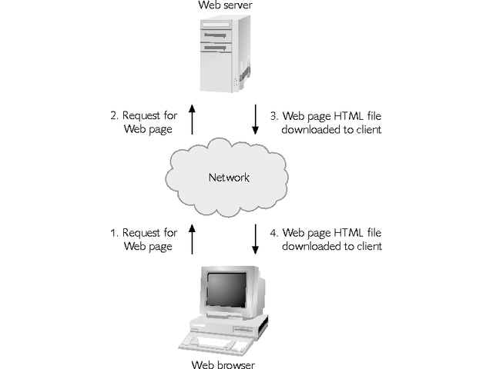
Review of Web Architecture Concepts
The Web has a client/server architecture
Programs on servers communicate and share files with client workstations over a network

Slide 4
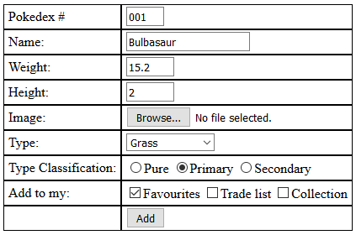
Review of Name/Value Pairs
REQUEST
txtPDexNo = 001
txtPName = Bulbasaur
txtPWeight = 15.2
txtPHeight = 2
cboType = 7
radTClass = Primary
chkAddTo = Favorites
RESPONSE
Resulting HTML page

Slide 5
Using XAMPP in Lab and at Home
Our project files will always reside in C:\xampp\htdocs
To execute pages in the browser:
Enter http://localhost/ProjectFolderName/PageName
NOTE: The page name is optional if an index.php page resides in the project folder
Overview of XAMPP Console
Running a test project: My first PHP site

Slide 6
Decomposing the JQuery and PHP Program
Client-side
Name attributes and form tags are critical!
When we use an input button of type submit, the page automatically sends all name/value pairs to the form’s action argument via its method
Server-side
Echo writes a response back to the client
NOTE: concatenation is done via the dot (.)

Slide 7
PHP Basics: Declaration Tags
<? PHP Code In Here
?>
<?php PHP Code In Here
?>
<script language="php"> PHP Code In Here
</script>

Slide 8
PHP Basics: Variables
Dollar sign is used in front to specify variable
No var syntax required
Variables are loosely typed
Variables are case-sensitive
Do not need to be declared before initialization
//sample variable declaration
$welcome = “Hello World”; //string
$cost = 599.99; //float

Slide 9
PHP Basics: Simple String Concepts
Concatenation with dot (.)
$first = “Bob”;
$last = “Evans”;
$name = $first . “ “ . $last;
Surround with single or double quotes
With this rule of thumb to escape inner quotes …
$myTag = “<input id=‘txtName’ name=‘txtName’ type=‘text’ >”;
or …
$myTag = ‘<input id=“txtName” name=“txtName” type=“text” >’;

Slide 10
PHP Basics: More on Strings
There is a benefit to nesting your string within double quotes! You can nest variables within the string.
$myPricing = 9.99;
echo “Your final total is: $myPricing”;
//outputs the following
Your final total is: 9.99
If you nest a variable within a string that has single quotes, it treats it literally
$myPricing = 9.99;
echo ‘Your final total is: $myPricing’;
//outputs the following
Your final total is: $myPricing
The fix to the problem of using a string with single-quotes is to stop the literal part of the string and concatenate the variable to it using dot notation

Slide 11
PHP Basics: Difference Between Running Total and Concatenated String
Since the plus sign (+) is only for math, and the dot (.) is only for string concatenation …
To do a running total:
$total = 0;
$total += 2;
To build a running string:
$message = “Hello ”;
$message .= “World”;

Slide 12
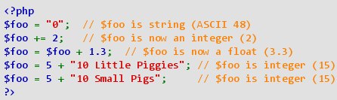
PHP Basics: Handling Types
No explicit types required
Variables are determined via its context
Using the dot to concatenate makes the plus sign unambiguous – only used for numeric addition
PHP Manual link to this information

Slide 13
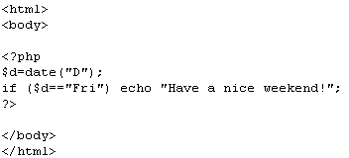
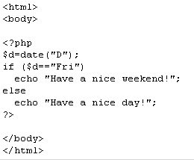
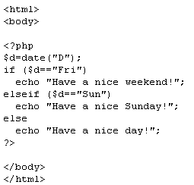
PHP Basics: Decision Structures
Only one option
Either/or option
Many options

Slide 14
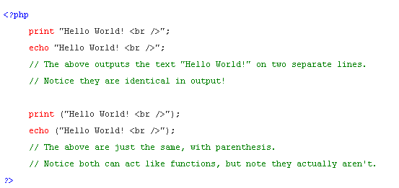
PHP Basics: Writing a Response

Slide 15
$_GET and $_POST Arrays
Both are associative arrays
Meaning that it associates a value with a name
If you reference a name, the value is returned
Global to the entire page to which it is sent
Need to match the name part up to the name attributes from the calling program
<input id=“txtName” name=“txtName”>
//catch the name value from the client page
$name= $_POST[“txtName”]; //$name holds ‘Marsha’

Slide 16
Practice Time
In-class exercise building your first PHP program
Review and discuss

